Slide 1



Digital Marketing Process for Adidas
Adidas, the renowned sportswear brand, has a sophisticated digital marketing strategy that encompasses various facets to engage their target audience and drive brand awareness. This presentation will explore Adidas' digital marketing process, objectives, buyer persona, strategies, media investments, digital presence, and social media platforms.
By Paramjeet Singh Bill Gates

Slide 2

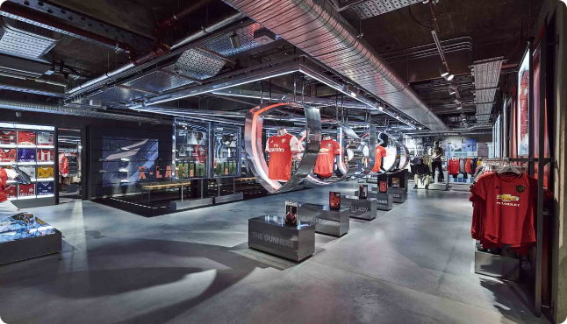
Objectives
Adidas' digital marketing objectives are focused on increasing brand visibility, driving online sales, and fostering stronger customer relationships. They aim to create compelling content that resonates with their target audience, optimize their digital channels for better user experience, and leverage data-driven insights to refine their marketing efforts.

Slide 3
Buyer Persona:
Name: Ayush Singh
Demographics:
•Age: 29
•Gender: Male
•Marital Status: Unmarried
•Education: Banker
•Income: 16lakh per year
•Location: Gurugram
Personal Background:
Hobbies: Traveling, Reading, Yoga, Photography,
Cooking.
Human Values: Individuality, Sustainability, Quality, Style,
Comfort.
Personality:
• Fashion-conscious
• Confident
• Adventurous
• Environmentally aware
• Practical
Goals:-
• Primary Goal: To stay updated with the latest shoes trends while maintaining a sustainable lifestyle.
• Secondary Goal: To build a versatile shoes collection that reflects his personality.

Slide 4
Challenges:-
• Primary Challenge: Finding affordable, high-quality shoes that aligns with his values.
• Secondary Challenge: Staying true to his style amidst fast-changing fashion trends.
Behavioural Traits:-
• Shopping Preferences: Online shopping, sales, and discounts
• Technology Usage: Active on social media, uses fashion apps
• Buying Influence: Influenced by social media, fashion bloggers, friends, and celebrity endorsements
Preferred Shoes Brands:-
Under Armour
Puma
Converse
New Balance
Nike
Adidas
Marketing Message:-
• Core Message: "Sustainable fashion for the modern, conscious individual“
• Value Proposition: ”Adidas offers on-trend, affordable shoes while prioritizing sustainability and quality“
Channel and Content:-
• Preferred Channel: Social media (Instagram, Facebook)
• Content Type: Visual storytelling, influencer partnerships, user-generated content, educational content on sustainability, and
styling tips.
Suggestions from Ayush to ADIDAS :-
• Collaborate with eco-friendly influencers for brand promotion
• Increase transparency about sustainable practices- Offer personalized styling services online
• Expand plus-size and diverse model representation in marketing campaigns
• Host workshops on sustainable fashion practices

Slide 5

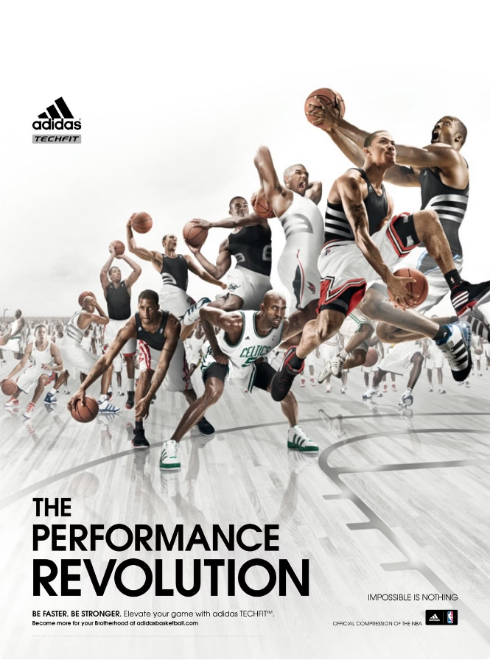
Adidas Strategies: Past, Present, and Future
1
Past
Adidas has a rich history of leveraging traditional marketing channels, such as print ads, sponsorships, and TV campaigns, to build brand recognition and loyalty.
2
Present
In recent years, Adidas has shifted its focus to digital marketing, investing heavily in social media, influencer partnerships, and data-driven campaigns to reach their target audience more effectively.
3
Future
Looking ahead, Adidas plans to further enhance its digital presence, exploring emerging technologies like augmented reality, personalized recommendations, and integrated customer experiences to stay ahead of the curve.

Slide 6

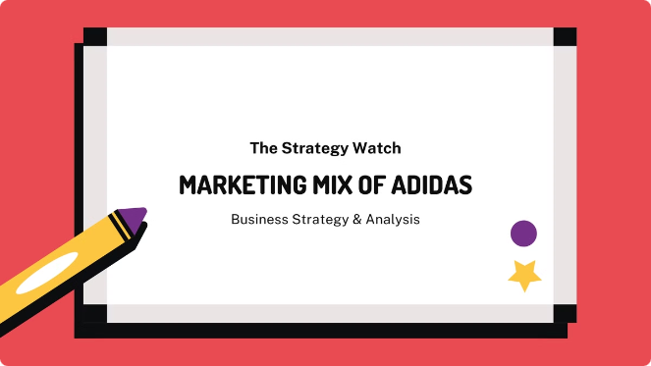
Adidas' Investments in Paid, Earned, and Owned Media
Paid Media
Earned Media
Adidas allocates a significant portion of its marketing budget to paid advertising, leveraging platforms like Google Ads, social media ads, and programmatic display to reach their target audience and drive conversions.
Adidas has built a strong reputation through strategic partnerships with influencers, athletes, and media outlets, generating valuable earned media coverage that enhances brand awareness and credibility.
Owned Media
Adidas invests heavily in their owned media channels, such as their website, mobile app, and social media platforms, to create engaging content, foster brand loyalty, and provide a seamless customer experience.

Slide 7
Adidas' Digital Presence: Microsite or Website
Microsite
Website
Optimization
Adidas often leverages microsites to showcase specific product lines, campaigns, or initiatives, providing a more immersive and focused digital experience for their target audience.
Adidas' main website serves as the central hub for their digital presence, offering a comprehensive e-commerce platform, content library, and customer support resources to cater to the diverse needs of their audience.
Adidas continuously optimizes its digital platforms, leveraging data-driven insights and user feedback to enhance functionality, design, and overall user experience, ensuring their customers can seamlessly engage with the brand.

Slide 8

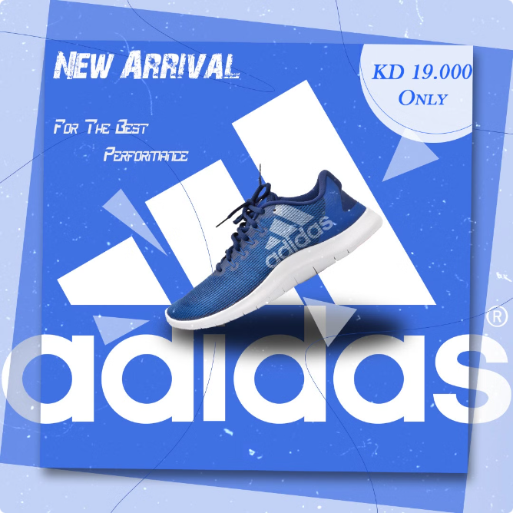




Adidas' Social Media Platforms
Instagram
Twitter
Adidas leverages Instagram to showcase their products, share behind-the-scenes content, and partner with influential athletes and creators to reach a visually-oriented audience.
Adidas uses Twitter to engage in real-time conversations, respond to customer queries, and leverage trending hashtags to amplify their brand messaging and stay relevant in the social media landscape.
YouTube
TikTok
Adidas maintains a robust YouTube channel, featuring product demos, behind-the-scenes videos, and branded content that showcases their brand story and athletes, creating an immersive viewing experience.
As a newer platform, Adidas has embraced TikTok's short-form video format to connect with a younger, more viral-driven audience, leveraging user-generated content and trending challenges to drive brand awareness.

Slide 9

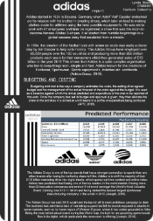



Adidas' Digital Marketing Budget Allocation
Paid Advertising
Content Creation
Data Analytics
Adidas allocates a significant portion of its digital marketing budget to paid advertising, including search engine marketing, social media ads, and programmatic display campaigns to reach a wider audience and drive conversions.
Adidas invests in creating engaging, high-quality content, such as product videos, brand storytelling, and influencer collaborations, to build brand loyalty and increase customer engagement.
Adidas dedicates a portion of its digital marketing budget to data analytics, leveraging insights to optimize their campaigns, personalize customer experiences, and make informed, data-driven decisions.

Slide 10

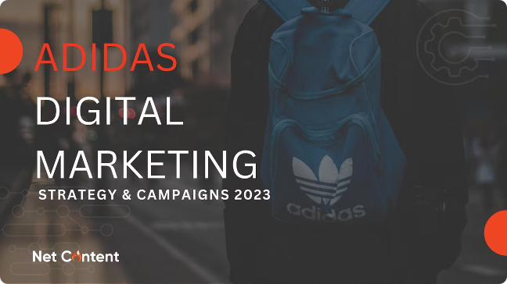
Conclusion
1
Comprehensive Approach
2
Adapting to Trends
Adidas remains agile and adaptable, embracing emerging technologies and platforms to stay ahead of the curve and connect with their customers in innovative ways.
Adidas has a well-rounded digital marketing strategy that encompasses paid, earned, and owned media channels to reach and engage their target audience effectively.
3
Data-Driven Optimization
Adidas leverages data-driven insights to continuously refine and optimize their digital marketing efforts, ensuring they deliver personalized and impactful experiences for their customers.

